Slide 1
Java Servlet Programming

Slide 2
Topics
Server Side Programming in Java
Servlet API
Servlet Life Cycle
Session Tracking

Slide 3
What is a Servlet?
Java’s answer to the Common Gateway Interface (CGI).
Applet:
  a java program that runs within the web browser.
Servlet:
  a java program that runs within the web server.
  Controlled by an environment in the server-often called “servlet engine”
  One of the important J2EE “application components”.

Slide 4
Server Side Programming
Servlets are Server-side programs executed by “Web Servers”.
Programs needed on Server-side
  Dynamic Content generation
  Authentication
  Database access
  Concurrent request processing
  Transactions

Slide 5
Web Servers
Basically created for serving pages that can be interpreted by a browser.
Content of the pages in a web server are static.
Typical extensions are html, htm etc.
In serving static content, there is minimal processing needed on the server.

Slide 6
Dynamic Pages
The web server generates the page to be served dynamically
  Typically inputs from the HTTP request are used for this generation
  E.g In google.com the text that you are searching for is the input for the result page generation.

Slide 7
Web Technologies
Traditional CGI
  The first web applications were written in as CGI scripts.
  Scalability and performance was very poor
    Process oriented
    No resource reuse
    Difficult inter-process communication etc
Microsoft ASP
  ISAPI (Proprietary API of Microsoft) for IIS.
  ASP - Microsoft’s revolutionary technology for dynamic page generation was extremely good but lacked portability.
Netscape NSAPI
  Proprietary API’s NSAPI Netscape was better in performance but again lacks portability.

Slide 8
Web Technologies…
Sun Microsystems
  Java Servlets
    Sun Microsystems “initial” option for dynamic web page creation.
    Was competing to CGI in initial days
    Is efficient in terms of
      Threading
      Resource sharing
      Portability
      Simplicity
  Java Server Pages
    Also called JSP – is the next generation of Servlets
    Very similar to ASP other than that it uses Java as the scripting language
    Powerful

Slide 9
Java Servlets
A Servlet is a dynamically loaded module that services requests from a Web server.
Common use is to extend Web servers, providing a very secure,portable and easy to use replacement for CGI.

Slide 10
Advantages of Servlets
Servlets have six main advantages:
  Efficient
  Convenient
  Powerful
  Portable
  Secure
  Inexpensive

Slide 11
Advantage 1: Efficient
For each browser request, the servlet spawns a light weight thread.
This is faster and more efficient that spawning a new operating system process.
Hence, servlets have better performance and better scalability than traditional CGI.

Slide 12
Advantage 2: Convenient
Servlets include built-in functionality for:
  Reading HTML form data
  Handling cookies
  Tracking user sessions
  Setting HTTP headers
Java is object oriented

Slide 13
Advantage 3: Powerful
Servlets can talk directly to the web servers.
Multiple servlets can share data:
  Particularly important for maintaining database connections.
Includes powerful techniques for tracking user sessions.

Slide 14
Advantage 4: Portable
One of the advantages of Java is its portability across different operating systems.
Servlets have the same advantages.
You can therefore write your servlets on Windows, then deploy them on UNIX.
You can also run any of your servlets on any Java-enabled web server, with no code changes.

Slide 15
Advantage 5: Secure
Traditional CGI programs have a number of known security vulnerabilities.
Hence, you usually need to include a separate Perl/CGI module to supply the necessary security protection.
Java has a number of built-in security layers.
Hence, servlets are considered more secure than traditional CGI programs.

Slide 16
Advantage 6: Inexpensive
You can download free servlet kits for development use.

Slide 17
Execution of a Servlet
Request
Request
Web browser
Web Server
Servlet
Response
Response

Slide 18
An Example
  import java.io.*;
  import javax.servlet.*;
  public class HelloWorldServlet extends GenericServlet{
  public void service(ServletRequest request,
  ServletResponse response)
  throws ServletException ,IOException{
response.setContentType(“text/html”);
PrintWriter pw=response.getWriter();
pw.println(“<b> Hello World !”);
pw.close();
}
}

Slide 19
Java Servlet Architecture

Slide 20
Java Servlet Architecture
The Java Servlet API defines the interface between servlets and servers
Two packages make up the servlet architecture
javax.servlet
javax.servlet.http

Slide 21
Servlet Architecture…
javax.servlet.Servlet
javax.servlet.
ServletConfig
Java.io.
Serializable
javax.servlet.GenericServlet
javax.servlet.http.HttpServlet

Slide 22
Servlet Architecture…
The javax.servlet package contains the generic interfaces and classes that are implemented and extended by all Servlets.
The javax.servlet.http package contains the classes that are extended when creating HTTP - specific Servlets.

Slide 23
Your Servlet?
Servlets
Generic Servlet
HttpServlet
MyServlet

Slide 24
The Servlet API
Provides support in 4 categories:
  Servlet life cycle management
    init(), service(), destroy(), doGet(), doPost()
  Access to servlet context
    ServletContext object used
  Utility classes
    javax.servlet.SingleThreadModel
    javax.ServletException
  Http-specific support classes

Slide 25
Http Servlets

Slide 26
Http Support Classes
javax.servlet.http.HttpServlet abstract class provides an implementation of the javax.servlet.Servlet interface, and includes a lot of helpful default functionality
HttpServlet class provides an implementation of service() method that dispatches the Http messages to one of the several special methods:
  doGet()
  doPost(), etc.

Slide 27
Http Request Methods
The GET method
  Can pass limited data
  Pass parameter data to the server in the URL
  e.g., GET /servlet/Hello?name=Scott
  For more data, use POST
The POST method
  Passes its parameter data to the server in an input stream

Slide 28
Coding an HttpServlet
Create a new servlet that extends HttpServlet and overrides either doGet(), or doPost(), or both
doGet() method should
  Read request data, such as i/p parameters
  Set response headers (length, type, encoding, etc.)
  Write response data

Slide 29
Coding an HttpServlet…
doPost() method
  Functionality similar to doGet()
  To be overridded when you need to process an HTML form posting or to handle large amount of data being sent by a client

Slide 30
Typical Http Servlet Functioning
Regardless of the application, servlets usually carry out the following routine:
Read any data sent by the user
  Capture data submitted by an HTML form.
Look up any HTTP information
  Determine the browser version, host name of client, cookies, etc.
Generate the Results
  Connect to databases, connect to legacy applications, etc.

Slide 31
Typical Http Servlet Functioning…
Format the Results
  Generate HTML on the fly
Set the Appropriate HTTP headers
  Tell the browser the type of document being returned or set any cookies.
Send the document back to the client

Slide 32
Typical Http Servlet Functioning…
Database
3
Web
Browser
Web
Server
1,2
Java
Servlet
6
4,5

Slide 33
Life Cycle of a Servlet

Slide 34
Life Cycle of a Servlet
Servlet Code
LOAD
Server
Server
Client
Servlet
Code
Client
Unload
Server
ServletCode

Slide 35
Life Cycle of a Servlet
init() method
  When a server loads a servlet, the server runs the servlet’s init method.
  Initialization completes before client requests are handled and before the servlet is destroyed.
  The init() method is where the servlet’s life begins.
  It is called only once.

Slide 36
Life Cycle of a Servlet
Service() method
  Handles all request sent by the client
  Has 2 parameters:
    The ServletRequest object contains the information about the service request, encapsulating information provided by the client.
    The ServletResponse object contains the information returned to the client.

Slide 37
Life Cycle of a Servlet
destroy() method
  Servlets run until the server destroys them.
  When a server destroys a servlet , the server runs the servlet’s destroy method.
  The method is run once, the server will not run that servlet again until after the server reloads and reinitializes the servlet.

Slide 38
Code Walkthrough - HelloWorld
  import java.io.*;
  import javax.servlet.*;
  public class HelloWorldServlet extends GenericServlet{
  public void service(ServletRequest request,
  ServletResponse response)
  throws ServletException ,IOException{
response.setContentType(“text/html”);
PrintWriter pw=response.getWriter();
pw.println(“<b> Hello World !”);
pw.close();
}
}

Slide 39
The ServletRequest Interface
Allows the servlet access to
  Information such as
    the names of the parameters passed in by the client,
    the protocol (scheme) being used by the client, and
    the name of the remote host that made the request and the server that received it.
The input stream, ServletInputStream to get data from clients that use application protocols such as the HTTP POST

Slide 40
The ServletResponse Interface
Gives the servlet methods for replying to the client;
  Allows the servlet to set the content length and MIME type of the reply
  Provides an output stream, ServletOutputStream, and a Writer through which the servlet can send the reply data.

Slide 41
Overview of
Servlet Life Cycle

Slide 42
Life Cycle Stages of a Servlet
Birth: Create and initialize the servlet
  Important method: init()
Life: Handle 0 or more client requests
  Important method: service()
Death: Destroy the servlet
  Important method: destroy()

Slide 43
Birth

Slide 44
The init() method
The init() method is called when the servlet is first requested by a browser request.
It is not called again for each request.
Used for one-time initialization.
There are two versions of the init() method:
  Version 1: takes no arguments
  Version 2: takes a servletConfig object as an argument.

Slide 45
Example – init() method
The init() method is a good place to put any initialization variables.
For example, the following servlet records its Birth Date/time…

Slide 46
Example for Init Method
  import java.io.*;
  import java.util.*;
  import javax.servlet.*;
  import javax.servlet.http.*;
  public class Birth extends HttpServlet {
  Date birthDate;
  // Init() is called first
  public void init() throws ServletException {
  birthDate = new Date();
  }

Slide 47
Example for Init Method…
  // Handle an HTTP GET Request
  public void doGet(HttpServletRequest request,
  HttpServletResponse response)
  throws IOException, ServletException {
  response.setContentType("text/html");
  PrintWriter out = response.getWriter();
  out.println ("I was born on: <b>"+birthDate);
  out.close();
  }
  }

Slide 48
Life

Slide 49
Life of a Servlet
The first time a servlet is called, the Servlet is instantiated, and its init() method is called.
Only one instance of the servlet is instantiated.
This one instance handles all browser requests.

Slide 50
Service() Method
Each time the server receives a request for a servlet, the server spawns a new thread and calls the servlet’s service () method.
Browser
service()
Single Instance
of Servlet
Web Server
service()
Browser
service()
Browser

Slide 51
Let’s Prove it…
To prove that only one instance of a servlet is created, let’s create a simple example.
The Counter Servlet keeps track of the number of times it has been accessed.
This example maintains a single instance variable, called count.
Each time the servlet is called, the count variable is incremented.
If the Server created a new instance of the Servlet for each request, count would always be 0!

Slide 52
Example – service()
Only one instance of the
counter Servlet is created.
Each browser request is
therefore incrementing the
same count variable.
  import java.io.*;
  import javax.servlet.*;
  import javax.servlet.http.*;
  public class CounterServlet extends HttpServlet {
  // Create an instance variable
  int count = 0;

Slide 53
Example – service()…
  // Handle an HTTP GET Request
  public void doGet(HttpServletRequest request,
  HttpServletResponse response)
  throws IOException, ServletException {
  response.setContentType("text/html");
  PrintWriter out = response.getWriter();
  count++;
  out.println ("Since loading,
  this servlet has been accessed <b>"+ count
  + " times.");
  out.close();
  }
  }

Slide 54
The Service Method
By default the service() method checks the HTTP Header.
Based on the header, service calls either doPost() or doGet().
doPost and doGet is where you put the majority of your code.
If your servlets needs to handle both get and post identically, have your doPost() method call doGet() or vice versa.

Slide 55
Death

Slide 56
Death of a Servlet
Before a server shuts down, it will call the servlet’s destroy() method
You can handle any servlet clean up here For example:
  Updating log files
  Closing database connections
  Closing any socket connections

Slide 57
Example – destroy()
This example illustrates the use of the destroy() method.
While alive, the servlet will say “I am alive!”.
When the server is stopped, the destroy() method is called, and the servlet records its time of death in a “rip.txt” text file.

Slide 58
Example – destroy()
  import java.io.*;
  import java.util.*;
  import javax.servlet.*;
  import javax.servlet.http.*;
  public class Death extends HttpServlet {
  // Handle an HTTP GET Request
  public void doGet(HttpServletRequest request,
  HttpServletResponse response)
  throws IOException, ServletException {
  response.setContentType("text/plain");
  PrintWriter out = response.getWriter();
  out.println ("I am alive!");
  out.close();
  }

Slide 59
Example – destroy()…
  // This method is called when one
  // stops the Web Server
  public void destroy() {
  try {
  FileWriter fileWriter =
  new FileWriter ("rip.txt");
  Date now = new Date();
  String rip = "I was destroyed at: " +
  now.toString();
  fileWriter.write (rip);
  fileWriter.close();
  } catch (IOException e) {
  e.printStackTrace();
  }
  }
  }

Slide 60
Thread Synchronization
By default, multiple threads are accessing the same servlet at the same time.
You therefore need to be careful to synchronize access to shared data.
  For example, what happens if two browsers request a stock trade for the same account at the same time.
Synchronization is, however a large topic in itself, and we do not have time to discuss all the issues.
Nonetheless, there is an option called the SingleThreadModel…

Slide 61
SingleThreadModel Interface
To prevent multi-threaded access, you can have your servlet implement the SingleThreadModel:
  public class YourServlet extends HttpServlet implements SingleThreadModel
  {
  …
  }

Slide 62
SingleThreadModel Interface
This will guarantee that your servlet will only process one browser request at a time.
It therefore addresses most synchronization issues.
Unfortunately, this can result in severe slowing of performance

Slide 63
Putting it all together

Slide 64
A Persistent Counter
Now that we know all about the birth, life and death of a servlet, let’s put this knowledge together to create a persistent counter.
The CounterServlet.java example we covered earlier has a big problem:
  When you restart the web server, counting starts all over at 0.
  It does not retain any persistent memory.

Slide 65
Persistent Counter
To create a persistent record, we can store the count value within a “counter.txt” file.
  init(): Upon start-up, read in the current counter value from counter.txt.
  destroy(): Upon destruction, write out the new counter value to counter.txt

Slide 66
Example – Persistent Counter
  import java.io.*;
  import javax.servlet.*;
  import javax.servlet.http.*;
  public class CounterPersist extends HttpServlet {
  String fileName = "counter.txt";
  int count;

Slide 67
Example – Persistent Counter…
At Start-up, load the counter from file.
In the event of any exception, initialize
count to 0.
  public void init () {
  try {
  FileReader fileReader = new FileReader
  (fileName);
  BufferedReader bufferedReader = new
  BufferedReader (fileReader);
  String initial = bufferedReader.readLine();
  count = Integer.parseInt (initial);
  } catch (FileNotFoundException e) {
  count = 0;
  } catch (IOException e) {
  count = 0;
  } catch (NumberFormatException e) {
  count = 0;
  }
  }

Slide 68
Example – Persistent Counter…
Each time the doGet() method is called, increment the count variable.
  // Handle an HTTP GET Request
  public void doGet(HttpServletRequest request,
  HttpServletResponse response)
  throws IOException, ServletException {
  response.setContentType("text/plain");
  PrintWriter out = response.getWriter();
  count++;
  out.println ("Since loading, this servlet has "
  +"been accessed <strong>"+ count +
  "</strong> times.");
  out.close();
  }

Slide 69
Example – Persistent Counter…
When destroy() is called, store new counter variable back to counter.txt.
  // At Shutdown, store counter back to file
  public void destroy() {
  try {
  FileWriter fileWriter =
  new FileWriter (fileName);
  String countStr = Integer.toString (count);
  fileWriter.write (countStr);
  fileWriter.close();
  } catch (IOException e) {
  e.printStackTrace();
  }
  }
  }

Slide 70
Servlets and HTML

Slide 71
Servlets and HTML
Servlets can receive information from the client in the form of HTML also.
All services are handled in the form of HTTP requests and responses only.
Commonly receive data from GET and POST requests.

Slide 72
HTTP GET Request
The html file contains a select element and a submit button.
Action attribute in FORM tag specifies the URL. This identifies to process HTTP GET request.
It uses getParameter() method to find the selection made by the user.
Parameters in GET request are apart of URL.

Slide 73
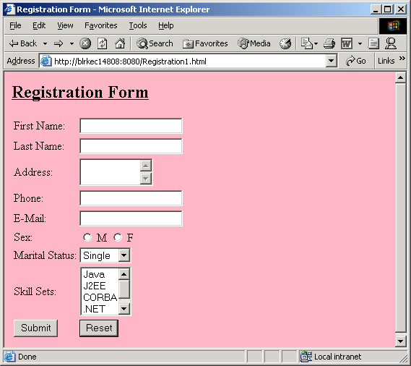
Example - Registration

Slide 74
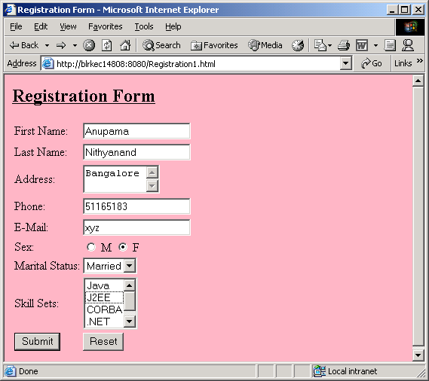
Example – Registration…

Slide 75
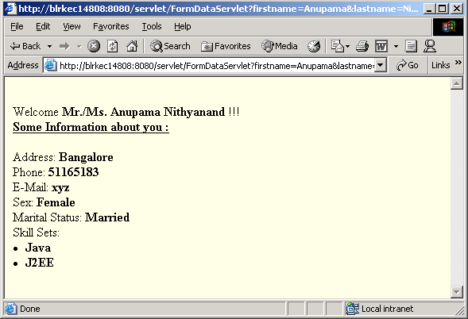
Example – Servlet Output

Slide 76
Registration1.html
<html>
<head>
<title> Registration Form </title>
</head>
<body bgcolor=lightpink>
<form action=
"http://blrkec14808:8080/servlet/FormDataServlet"
method=get>
<u><h2> Registration Form </h2></u>
<table>
<tr>
<td> First Name: </td>
<td> <input type=text name=firstname> </td>
</tr>
<tr>
<td> Last Name: </td>
<td> <input type=text name=lastname> </td>
</tr>

Slide 77
Registration1.html…
<tr>
<td> Address: </td>
<td><textarea rows=2 cols=10 name=address></textarea></td>
</tr>
<tr>
<td> Phone: </td>
<td> <input type=text name=phone> </td>
</tr>
<tr>
<td> E-Mail: </td>
<td> <input type=text name=email> </td>
</tr>
<tr>
<td> Sex: </td>
<td> <input type=radio name=sex value="Male"> M <input type=radio name=sex value="Female"> F </td>
</tr>

Slide 78
Registration1.html…
<tr>
<td> Marital Status: </td>
<td> <select name = mstatus >
<option value="Single">Single</option>
<option value="Married">Married</option>
</select>
</td>
</tr>
<tr>
<td> Skill Sets: </td>
<td> <select name=skillset multiple>
<option value="Java">Java</option>
<option value="J2EE">J2EE</option>
<option value="CORBA">CORBA</option>
<option value=".NET">.NET</option>
<option value="COM">COM</option>
</td>
</tr>

Slide 79
Registration1.html…
<tr>
<td>
<input type=submit name=submit value=Submit>
</td>
<td>
<input type=reset name=reset value=Reset>
</td>
</tr>
</table>
</form>
</body>
</html>

Slide 80
Example - FormDataServlet.java
import java.io.*;
import javax.servlet.*;
import javax.servlet.http.*;
public class FormDataServlet extends HttpServlet {
public void doGet(HttpServletRequest request,
HttpServletResponse response)
throws ServletException, IOException {
response.setContentType("text/html");
PrintWriter out=response.getWriter();

Slide 81
Example - FormDataServlet.java…
out.println("<body bgcolor=lightyellow>");
out.println("<br> Welcome <b> Mr./Ms.
"+request.getParameter("firstname")+ " " +
request.getParameter("lastname")+"</b> !!!");
out.println(" <br><u><b>Some Information about you :
</b></u><br><br>");
out.println(" Address: <b>
"+request.getParameter("address")+"</b><br>");
out.println(" Phone: <b>
"+request.getParameter("phone")+"</b><br>");

Slide 82
Example - FormDataServlet.java…
out.println(" E-Mail: <b>
"+request.getParameter("email")+"</b><br>");
out.println(" Sex: <b>
"+request.getParameter("sex")+"</b><br>");
out.println(" Marital Status: <b>
"+request.getParameter("mstatus")+"</b><br>");
out.println(" Skill Sets: ");
String skill[] =
request.getParameterValues("skillset");
for(int i=0;i<skill.length;i++)
out.println(" <b> <li> "+skill[i]+"</li> </b>");
out.close();
}
}

Slide 83
Servlet Context

Slide 84
Servlet Context
A Servlet lives and dies within the bounds of the server process.
A servlet can get information about its environment at different times.
Initialization information is passed to the servlet via the ServletConfig parameter of the init() method.

Slide 85
Servlet Context
Server context information is available at any time through the ServletContext object.
A servlet can obtain this object by calling the getServletContext() method on the ServletConfig object.
The ServletConfig object is set during init().

Slide 86
Servlet Context
Use it to know about the server
From Servlet Context you get
  information about a server via attribute name/value pairs
  the MIME type of a given file.
  name and version of the network service under which the servlet is running
  Etc., etc., …

Slide 87
Getting the Server Information
Called using the ServletRequest object
getServerName()
getServerPort()
getServerInfo()
getAttribute()
getAttributeNames()
Called using the ServletContextobject

Slide 88
Getting the Client Information
getRemoteAddr()
getRemoteHost()
getProtocol()
Called using the ServletRequest object

Slide 89
Accessing HTTP Headers
To access any of these Headers, the use the HTTPServletRequest getHeader() method.
For example:
  String connection = req.getHeader(“Connection”);
To retrieve a list of all the Header Names, use the getHeaderNames() method.
  getHeaderNames() returns an Enumeration object.
For example:
  Enumeration enum = req.getHeaderNames();

Slide 90
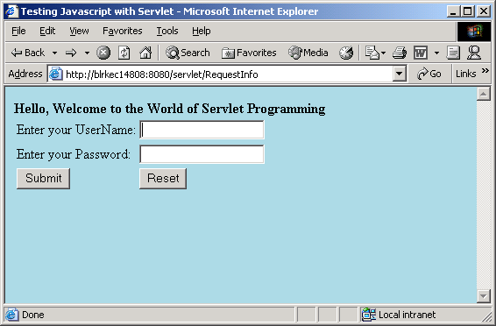
Example - Request Info and Display it

Slide 91
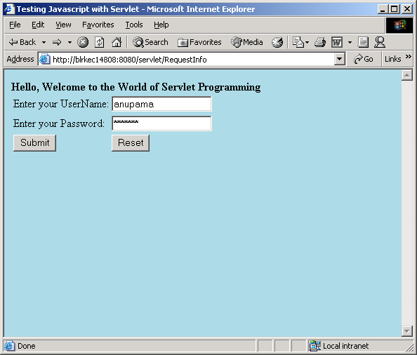
Example - Request Info and Display it…

Slide 92
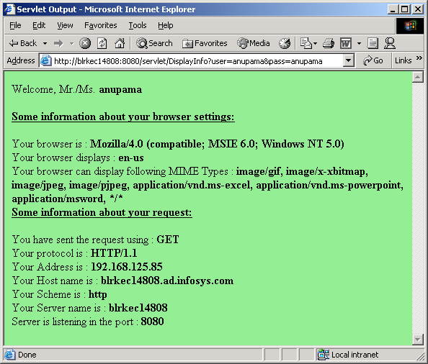
Example - Request Info and Display it…

Slide 93
RequestInfo.java
import javax.servlet.*;
import javax.servlet.http.*;
import java.io.*;
public class RequestInfo extends HttpServlet {
public void doGet(HttpServletRequest request, HttpServletResponse response)
throws ServletException, IOException {
PrintWriter out=response.getWriter();
response.setContentType("text/html");
out.println("<html>");
out.println("<head>");
out.println("<title>Testing Javascript with
Servlet</title>");
out.println("</head>");
out.println("<body bgcolor=lightblue>");

Slide 94
RequestInfo.java…
out.println("<script language=Javascript1.2>");
out.println("function validate()");
out.println("{");
out.println("if(document.test.user.value == \"\")");
out.println("{");
out.println("alert(\"Please Enter your username \");");
out.println("document.test.user.focus();");
out.println("return;");
out.println("}");
out.println("if(document.test.pass.value == \"\")");
out.println("{");
out.println("alert(\"Please enter your password\");");
out.println("document.test.pass.focus();");
out.println("return;");
out.println("}");
out.println("if(document.test.user.value!= \"\" &&
document.test.pass.value != \"\")");
out.println("{ document.test.submit(); } }");
out.println("</script>");

Slide 95
RequestInfo.java…
out.println("<form name=test
action=\"http://blrkec14808:8080/servlet/DisplayInfo\" method=get>");
out.println("<b> Hello, Welcome to the World of Servlet Programming");
out.println("<table><center><tr><td>Enter your UserName: </td><td><input type=text
name=user></input></td></tr>");
out.println("<tr><td>Enter your Password: </td><td><input type=password name=pass></input></td></tr>");
out.println("<tr><td><input type=button name=click value=Submit onclick=javascript:validate()></td>");

Slide 96
RequestInfo.java…
out.println("<td><input type=reset name=Reset value=Reset></td></tr>");
out.println("</table>");
out.println("</center>");
out.println("</form>");
out.println("</body>");
out.println("</html>");
out.close();
}
}

Slide 97
DisplayInfo.java
import javax.servlet.*;
import javax.servlet.http.*;
import java.io.*;
public class DisplayInfo extends HttpServlet {
public void doGet(HttpServletRequest request,
HttpServletResponse response)
throws ServletException, IOException {
doPost(request,response);
}

Slide 98
DisplayInfo.java…
public void doPost(HttpServletRequest request, HttpServletResponse response) throws
ServletException, IOException {
PrintWriter out=response.getWriter();
String username = request.getParameter("user");
String password = request.getParameter("pass");
out.println("<html>");
out.println("<head>");
out.println("<title>Servlet Output</title>");
out.println("</head>");
out.println("<body bgcolor=lightgreen>");
out.println(" Welcome, Mr./Ms. <b>
"+username+"</b><br><br>");
out.println(" <b><u>Some information about your
browser settings: </u></b><br><br>");

Slide 99
DisplayInfo.java…
out.println(" Your browser is : <b>
"+request.getHeader("user-agent")+"</b><br>");
out.println(" Your browser displays : <b>
"+request.getHeader("accept-language")+"</b><br>");
out.println(" Your browser can display following MIME Types:<b>"+request.getHeader("accept")+"</b><br>");
out.println(" <b><u> Some information about your request: </u></b><br><br>");
out.println(" You have sent the request using : <b>
"+request.getMethod()+"</b><br>");

Slide 100
DisplayInfo.java…
out.println(" Your protocol is : <b>
"+request.getProtocol()+" </b><br>");
out.println(" Your Address is : <b>
"+request.getRemoteAddr()+" </b><br>");
out.println(" Your Host name is : <b>
"+request.getRemoteHost()+" </b><br>");
out.println(" Your Scheme is : <b>
"+request.getScheme()+" </b><br>");
out.println(" Your Server name is : <b>
"+request.getServerName()+" </b><br>");
out.println(" Server is listening in the port : <b>
"+request.getServerPort()+" </b><br>");
out.close();
}
}

Slide 101
Example – Request Headers
import java.io.*;
import java.util.*;
import javax.servlet.*;
import javax.servlet.http.*;
public class RequestHeaderExample extends HttpServlet {
public void doGet(HttpServletRequest request,
HttpServletResponse response)
throws IOException, ServletException {
response.setContentType("text/html");
PrintWriter out = response.getWriter();
Enumeration e = request.getHeaderNames();
while (e.hasMoreElements()) {
String name = (String)e.nextElement();
String value = request.getHeader(name);
out.println(name + " = " + value+”<br>”);
}
}
}

